Slide 1
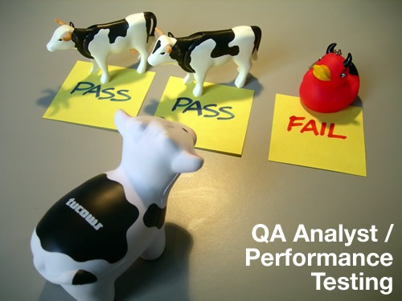
VGP104 - Software Development and Testing
Instructor: Peter Chan

Slide 2
Agenda
Verification and Validation
Static vs Dynamic Testing
Types of Software Testing
Rule #6 - Keep an Audit Trail

Slide 3
Verification:
    Ensures that the software has been built according to the design specification
Validation:
    Ensures that the product actually meets the user's needs
In other words, validation ensures that "you built the right thing", while verification ensures that "you built it right".

Slide 4
Static Testing
A form of testing where the software isn't actually used
Examples include reviews, walkthroughs, inspections
Static testing is about prevention

Slide 5
Dynamic Testing
Involves the actual execution of the software with a given set of test cases
May begin before the product is 100% complete to test particular sections of code (through the use of drivers and stubs)
Dynamic testing is about cure

Slide 6
Static vs Dynamic Testing
Many developers believe dynamic testing is more effective than static testing, in fact the opposite is true
Static testing find bugs earlier than dynamic testing, is more cost-effective, and has greater coverage
Static testing can also find problems such as hard to maintain code and poor designs

Slide 7
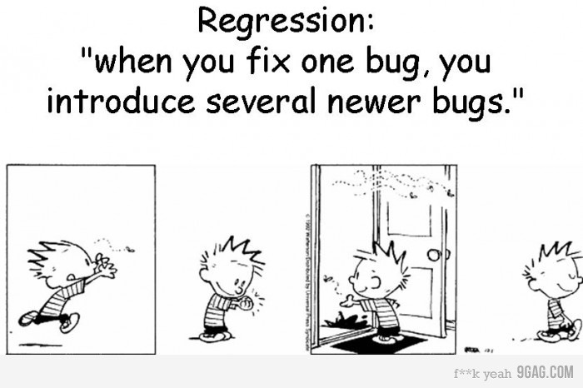
Types of Software Testing

Slide 8
Types of Software Testing
Unit Testing
Integration Testing
System Testing
Regression Testing
Acceptance Testing
Smoke Testing

Slide 9
Unit Testing
Also known as component testing
Verify the functionality of a specific section of code
The component can be a function or a class
Usually written by programmers as they work on code

Slide 10
Integration Testing
Testing of combined parts of an application to determine if they function together correctly
Verify the interfaces between components against a software design
The parts can be code modules, individual applications, or client/server applications on a network

Slide 11
System Testing
Testing conducted on a complete, integrated system to evaluate the system's compliance with it's specified requirements
High level testing that should require no knowledge of the inner design of the code or logic
Things to consider may include usability, performance, error handling, security, etc

Slide 12
Regression Testing
Focuses on finding defects after a major code change has occurred
Seeks to uncover old bugs that have come back, or functionality that was previously working correctly stops working as intended
Common methods include re-running previously run tests and automated test scripts

Slide 13
Acceptance Testing
Also known as User Acceptance Testing (UAT)
Testing performed by the customer to verify a product meets the specified requirements
May be performed as part of a hand-off process between any two phases of development

Slide 14
Smoke Testing
A quick-and-dirty test that the major functions of the software are working without bothering with the details
Used prior to introducing a new build to the main testing process to provide some assurance that the system will not catastrophically fail
"smoke testing" refers to physical tests made to closed pipes to test for leaks

Slide 15
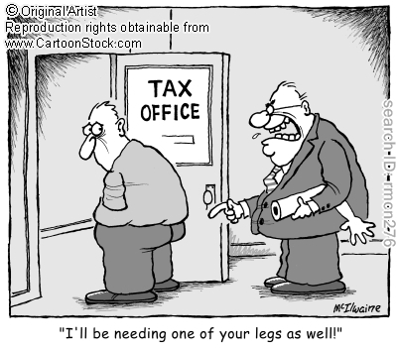
Rule #6 - Keep an Audit Trail

Slide 16
Rule #6 - Keep an Audit Trail
Sometimes the most insignificant-seeming thing is the key to making a bug happen
As you investigate a problem, write down what you did, what order you did it in, and what happened as a result
You have to be able to see the steps and results to determine which step to focus on during debugging

Slide 17
Rule #6 - Keep an Audit Trail
Don't forget the details, be specific and consistent with the descriptions, and correlate events
"It made a really loud noise" is good, but "It made a really loud noise for four seconds starting at 14:05:23" is better
Example: Coherence trace
Example: Perforce history

